Slide 2
HISTORY
Let us distribute yours!
PT. SAI Indonesia, formerly PT Sari Ayu Indonesia, (established in 1982), is a nationwide logistics and distribution company focusing on beauty and personal care products as well as complementary products.
The Company started the business with 2 branches in Jakarta and Surabaya.
.
Currently operates 1 Distribution Center (DC) in Jakarta providing products to 18 branch offices, 2 Sub Branches, 20 sub distributors, and 4 sales points across Indonesia to cover modern and conventional customers in line with the Principals’ marketing strategies.
PT. SAI Indonesia holds the ISO Certificate Indonesia in early 2012 for ISO implementation in its branches.

Slide 3
VISION & MISSION
Let us distribute yours!
VISION
To be the best local company in distribution and logistics provider nationwide.
MISSION
Distributing widerange of products to Indonesian people throughout the country as needed.

Slide 4
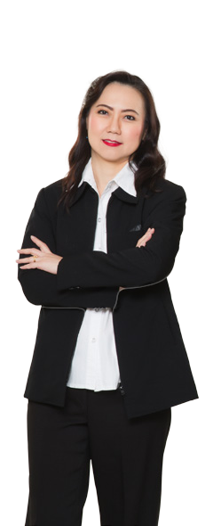
OUR CULTURE
Let us distribute yours!
Let us distribute yours!

Slide 5
Let us distribute yours!
OUR STRENGTH
Let us distribute yours!
Let us distribute yours!
INDONESIA
has been a long player in distribution business SINCE 1982
Therefore the company understands the culture and the needs of
Indonesian consumers, and has excellent relationships built with the
trade (outlets). It makes PT. SAI Indonesia become a reliable partner to its Principals.

Slide 6
OUR COMMITMENT
Let us distribute yours!
Let us distribute yours!
T H E C O M P A N Y I S
TO THE FUTURE INVESTMENTS AND
B U S I N E S S E X P A N S I O N
AND MAKING JOIN EFFORTS WITH
BUSSINESS PARTNERS TO ACHIEVE

Slide 7
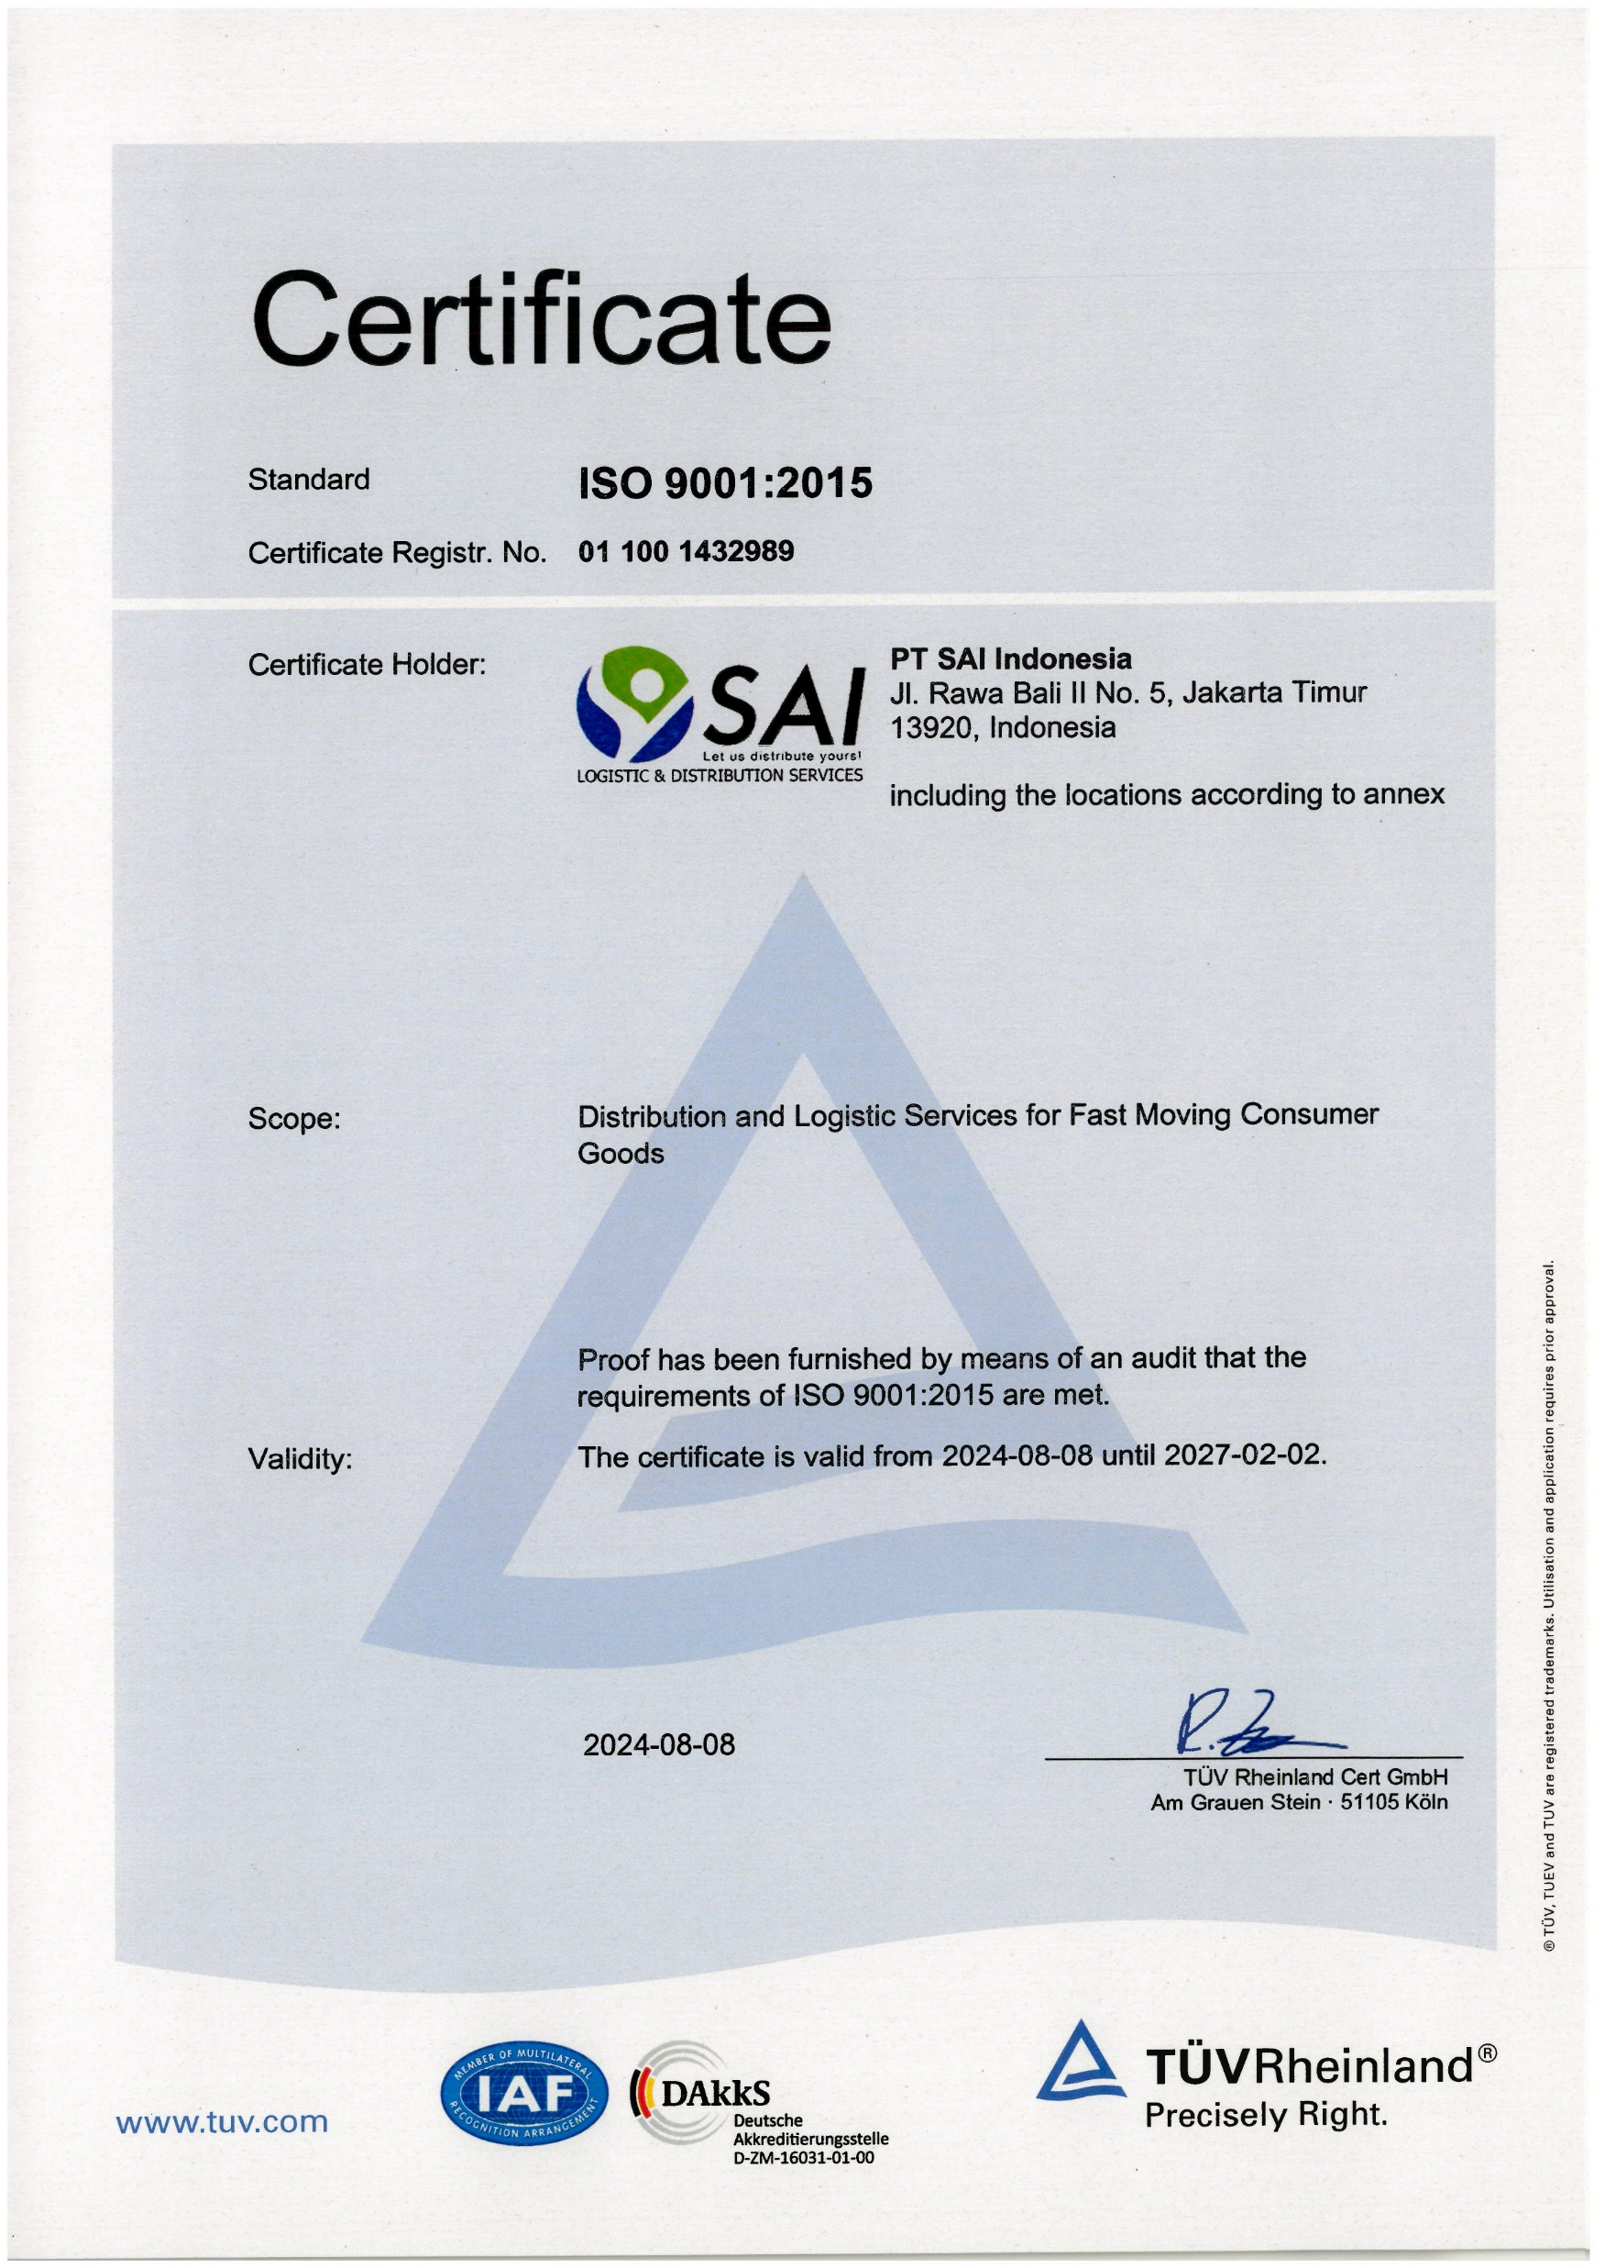
SERTIFIKAT ISO 9001- 2015
Let us distribute yours!

Slide 8
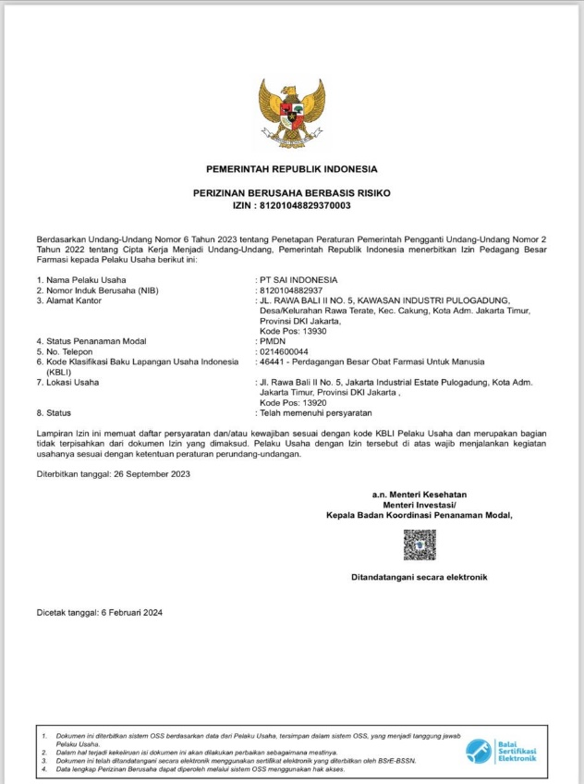
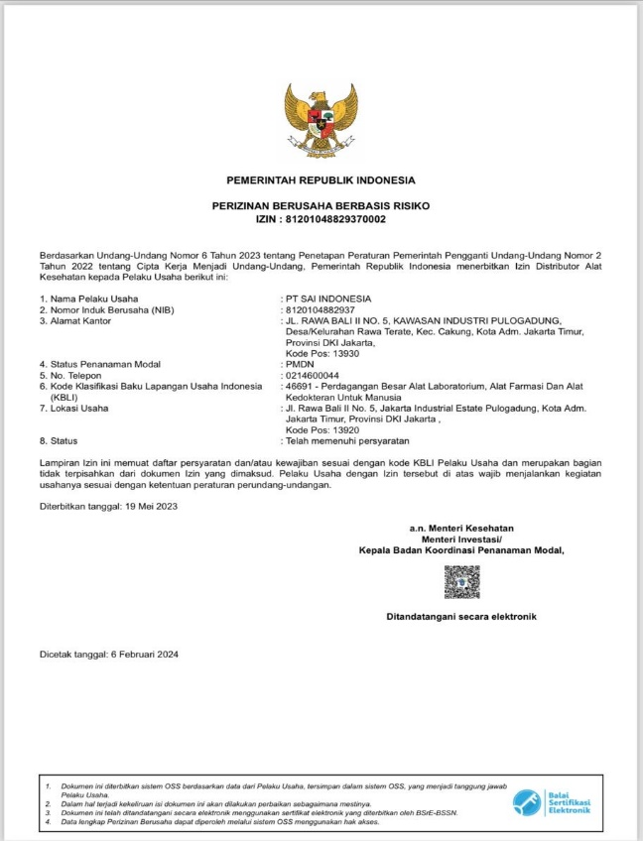
PBF & Medical Supplies Licenses
Let us distribute yours!

Slide 9
PRINCIPAL PRODUCT
SAI BRANDS
FLOW OF BUSINESS
Let us distribute yours!
MANUFACTURING
PRINCIPAL
BRAND OWNER
DISTRIBUTOR
PT. SAI INDONESIA
RETAILER
OUTLETS
END USER
CUSTOMER
SUBDIST
SAI BRANDS

Slide 10
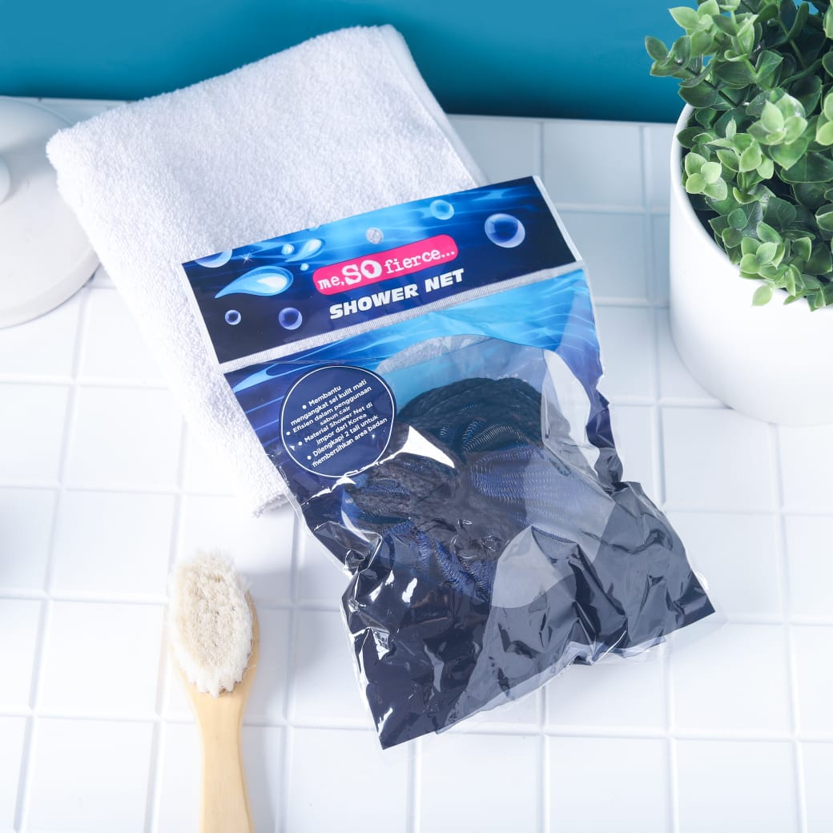
PRINCIPAL PRODUCT
SAI BRANDS
SAI BRANDS
Let us distribute yours!
SAI BRANDS

Slide 11
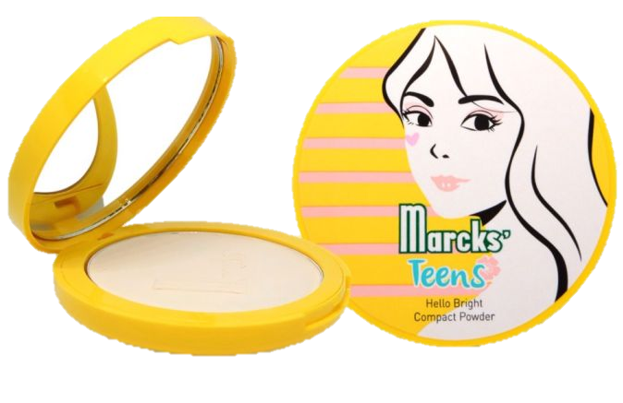
PRINCIPAL PRODUCT
PRINCIPAL’S PRODUCTS – BEAUTY & PERSONAL CARE
Let us distribute yours!
Let us distribute yours!
Let us distribute yours!
PT. UICCP INDONESIA
Skin Care
PT. FINE TODAY INDONESIA
Skincare, Face Wash
PT. SEMESTA DISTRIBUSI INDONESIA
(SOCIOLLA GROUP)
Skin Care
PT. KIMIA FARMA TBK
Personal Care & Cosmetics

Slide 12
PRINCIPAL PRODUCT
PRINCIPAL’S PRODUCTS – BEAUTY & PERSONAL CARE
Let us distribute yours!
Let us distribute yours!
Let us distribute yours!
PT. WAHANA KOSMETIKA INDONESIA
Skin Care & Cosmetics
PT. ROYAL PESONA INDONESIA
Skin Care & Cosmetics
PT. SINERGI MULTI DISTRINDO
Skin Care & Cosmetics
PT. ORE INTERNATIONAL DISTRIBUTION
Skin Care

Slide 13
PRINCIPAL PRODUCT
PRINCIPAL’S PRODUCTS – BEAUTY & PERSONAL CARE
Let us distribute yours!
Let us distribute yours!
Let us distribute yours!
PT. FCL INTERNASIONAL INDONESIA
Skin Care & Cosmetics
PT. BEAUTY SOURCE INDONESIA (SANIYE)
Cosmetics

Slide 14
PRINCIPAL PRODUCT
PRINCIPAL’S PRODUCTS – BEAUTY & PERSONAL CARE
Let us distribute yours!
Let us distribute yours!
Let us distribute yours!
PT. BERDIKARI PUTRA JAYA SEJAHTERA
Hair Color
PT. HOYU INDONESIA
Hair Color

Slide 15
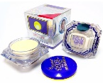
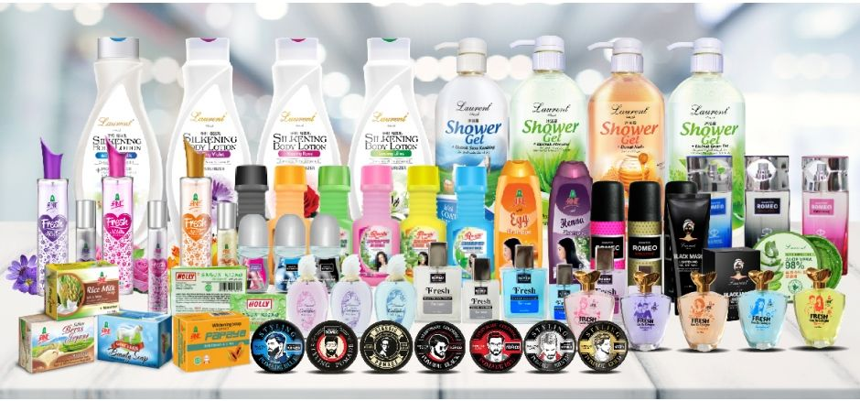
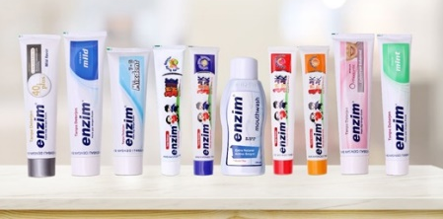
PRINCIPAL PRODUCT
PRINCIPAL’S PRODUCTS – BEAUTY & PERSONAL CARE
Let us distribute yours!
Let us distribute yours!
Let us distribute yours!
PT. ERA VENTURA INDONESIA
Shower Cream, Body Lotion
PT. CITRA USAHA LAMINDO
Accessories and Personal Care
PT. SEKAWAN KOSMETIK WASANTARA
Skin Care & Body Care
PT. ENZYM BIOTEKNOLOGI INTERNUSA
Mouth Care

Slide 16
PRINCIPAL PRODUCT
PRINCIPAL’S PRODUCTS – BEAUTY & PERSONAL CARE
Let us distribute yours!
Let us distribute yours!
Let us distribute yours!
PT. PRISKILA PRIMA MAKMUR
Personal Care
PT. AROMA PRIMA LIVINDO
Personal Care
PT. GRIFFIN PRIMA ABADI
Personal Care
PT. EASTON KALERIS INDONESIA
Personal Care

Slide 17
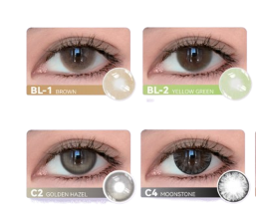
PRINCIPAL PRODUCT
PRINCIPAL’S PRODUCTS – BEAUTY & PERSONAL CARE
Let us distribute yours!
Let us distribute yours!
Let us distribute yours!
PT. WIREHE SUKSES BERSAMA
Softlenses

Slide 18
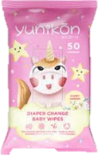
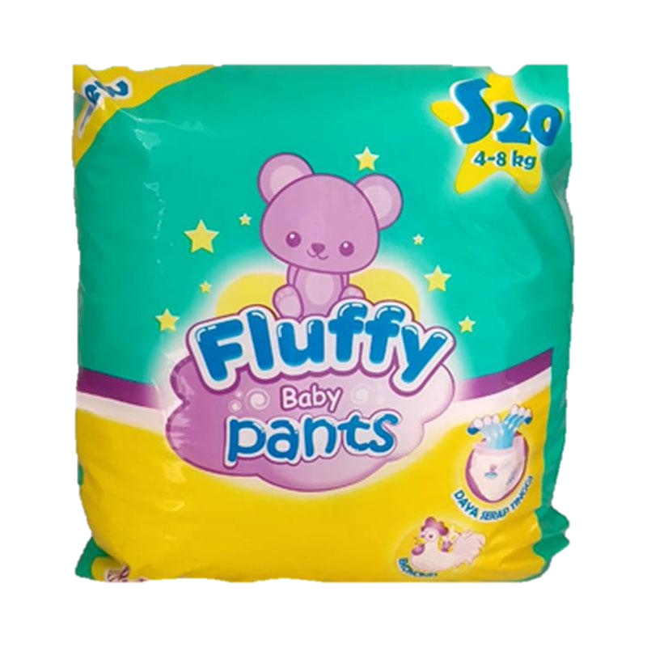
PRINCIPAL’S PRODUCTS – BABY, MOMS & KIDS
Let us distribute yours!
PT. TAK TERHINGGA SEPANJANG MASA
Baby care
PT. ANUGERAH SEJATI LARAS
Baby Care
PT. ETERCON PHARMA
Baby Care
PT. AMAN INDAH MAKMUR
Baby Care

Slide 19
PRINCIPAL’S PRODUCTS – FOODS & BEVERAGES
Let us distribute yours!
PT. HEAVENLY NUTRITION INDONESIA
Snacks & Beverages

Slide 20
PRINCIPAL’S PRODUCTS – HOUSEHOLDS & HOMECARE
Let us distribute yours!
PT UNITAMA SARI MAS
Household (air freshener, toiletries)
CV. JAYA WIJAYA NAGARA
Household
CV. MULIA MAS CEMERLANG
(PEACE KARBOL SEREH)
Household
PT. UICCP INDONESIA
Household (Detergent)

Slide 21
PRINCIPAL’S PRODUCTS – MEDICAL SUPPLIES
Let us distribute yours!
PT. Omron Healthcare Indonesia
Healthcare – Medical Supplies

Slide 22
SAI SERVICES
Let us distribute yours!
TRADE MARKETING MANAGEMENT
LOGISTICS
CHANNEL MANAGEMENT
DISTRIBUTION

Slide 23
SAI BRANCHES
Let us distribute yours!
18 Branches
DC
Distribution Center
2 Sub Branches (Depo)
Medan
Pekanbaru
Padang
Palembang
Lampung
Purwokerto
Jember
Jakarta
Tangerang
Bogor
Bandung
Cirebon
Batam, Tj Pinang, Bengkulu, Bangka, Kupang, Maumere ,Merauke, Ternate, Mimika, Jayapura, Sorong, Maumere, Ambon, Palu, Polewali, Kendari, Lombok, Pangkalan Bun, Manado, Samarinda.
Semarang
Yogyakarta
Surabaya
Kediri
Malang
20 Sub Dist
Denpasar
Makasar
Banjarmasin
4 Sales Point
Karawang, Serang, Solo, Tasik
Sales Point

Slide 24
SAI BRANCHES
Let us distribute yours!
DC
DC
Distribution Center
18 Branches
2 Sub Branches (Depo)
20 Sub Dist
4 Sales Point
Sales Point

Slide 25
FLEETS AND SALES FORCES
Let us distribute yours!
Approximately 45.000
Registered Outlets
With 25.000
Active Outlets
150
salesforces
45.152
total outlets
More Than
100 delivery vans

Slide 26
WAREHOUSE FACILITIES
Let us distribute yours!
Main distribution center warehouse located
at Pulo Gadung, Jakarta Timur
Thousands of pallet position capacity.
Safe handling supported by reach trucks,
Tri-Lateral Stacker , shrink pack and
stripping machines
Front distribution center located around
Indonesia
Electronic data processing by New SQL
platform and WMS System

Slide 27
IT FACILITIES
Let us distribute yours!
Online Salesman Order
WMS System
SAI Data Center (Server)
Web Report
SAI

Slide 28
IT FACILITIES
Let us distribute yours!
TAMPILAN WEB REPORT
1. Tampilan Login Webreport
3. Pilihan Consolidated
4. Data pada Webreport dapat
diexport menjadi format Excel
2. Pilihan Cabang Terkait

Slide 29
OTHER SERVICE
Let us distribute yours!
DISTRIBUTION ON LINE
Let us distribute yours!
Order Application
OUTBOND LOGISTIC

Slide 30
OTHER SERVICE
Let us distribute yours!
DISTRIBUTION ON LINE
Let us distribute yours!
ONLINE SHOP
OUTBOND LOGISTIC

Slide 31
THANK YOU
Let us distribute yours!

